Slide 1
EoL Educational Package 4 – Lesson 3: Personalised Care and Support Planning (PCSP)
September 2019

Slide 2
Lesson 3
Aim: To demonstrate ability to support the involvement of those close to the patient in this process according to the patient’s wishes.
Content:
Who should be involved?
The importance of involvement
Supporting caregivers

Slide 3
Who should be involved – relationship map
Notes:
A relationship map is a great way to think about all the people in a person’s life who might need to be involved in planning and decision making if they are unable to do that themselves. The people closest to the centre of the map in each area of the person’s life are the people who know them the best

Slide 4
Who should be involved - decision making agreement
Notes:
Following on from using the decision making profile tool, we also have the decision making agreement. This is a way of capturing information on who will have the final say for specific decisions when the person may no longer have the capacity for decision making themselves.
The left-hand column is the place to record each specific decision the agreement covers. The middle column is a place to record who will help the person with the decision and how they will do that. This can be populated with information from the decision-making profile tool about how to support the person to understand information and make decisions. The right-hand column records who makes the final decision and may be different for each specific decision.

Slide 5


The importance of involvement
Our commitment to you is that, as you approach the end of life, you should be given the opportunity and support to:
  ……Involve, to the extent that you wish, your family, carers and those important to you in discussions about, and the delivery of, your care, and to give them the opportunity to provide feedback about your care;
Reference
Our commitment to you for end of life care: The Government Response to the Review of Choice in End of Life Care
Notes:
Discussion – facilitator led
What does good care planning (with family/ carers) look like? How did it benefit the patient?
When would it be inappropriate to include family/ carers in care planning conversations?

Slide 6
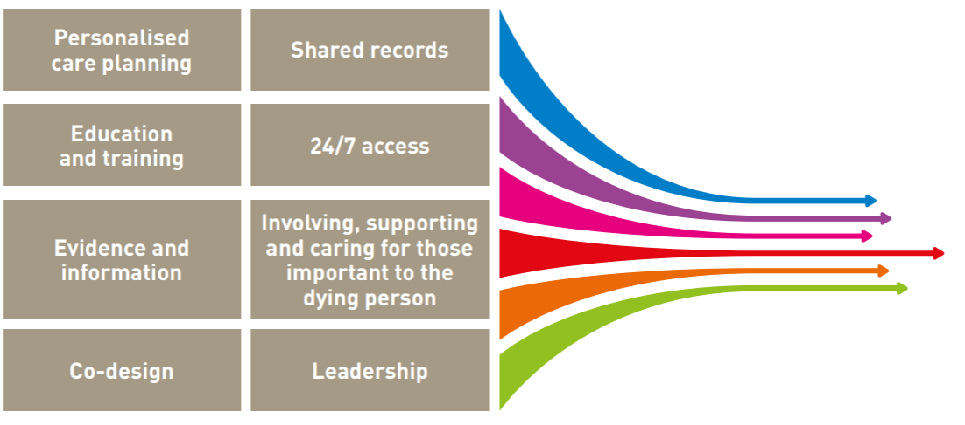
The importance of involvement continued
Good palliative and end of life care includes giving care and support to families, friends, carers and all those who are important to the dying person. This must encompass good bereavement and pre-bereavement care, including for children and young people. It must also respond to the needs of those who are affected by death caused by sudden illness or trauma, including suicide. As well as caring for them as individuals who are facing loss and grief, there needs to be recognition and support for their role as part of the person’s caring team, if they and the dying person wish them to be regarded in that way.
Notes:
Involving, supporting and caring for those important to the dying person is one of the 8 foundations (or pre-conditions) for the Ambitions for palliative and end of life care.
Caring for the individual includes understanding the need to support their unique set of relationships with family, friends, carers, other loved ones and their community, including preparing for loss, grief and bereavement.

Slide 7



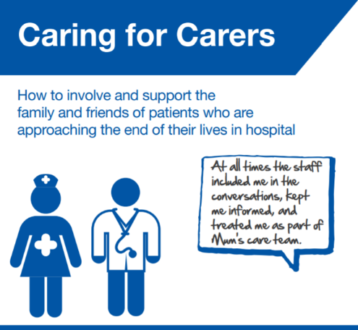
Supporting Caregivers
Anyone who looks after a partner, relative or friend who is disabled or ill due to physical or mental health, is a carer, even if they don’t think of themselves as one. Emotional, practical and financial support is available to carers and information is freely available:
Staff working in hospitals who may come into contact with a person who is approaching their end of life may find the ‘Caring for Carers’ publication useful – carers will be expert partners in the care of the person

Slide 8
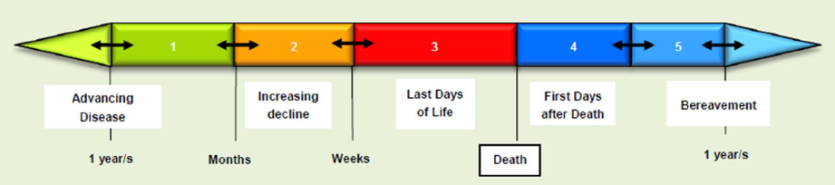
Supporting Caregivers
Carer support may be needed in the last years, months or days of life as well as in the year after death.
Educational Package 5 will look at how to identify carers of people who have advanced serious illness, it also considers how to enable carers’ needs to be assessed and addressed in a holistic way, before and after the patient’s death.

Slide 9
Key learning
Good palliative and end of life care includes giving care and support to families, friends, carers and all those who are important to the dying person.
Care and support must encompass good bereavement and pre-bereavement care, including for children and young people.
Information is widely available to support formal and informal caregivers.
Lesson 4 considers practice processes in terms of documenting PCSP, sharing the content with wider members of the tea and reviewing PCSP.

Slide 10
EoL Educational Package 4 – Lesson 4: Personalised Care and Support Planning (PCSP)
September 2019

Slide 11
Lesson 4
Aim: To consider practice processes in terms of documenting PCSP, sharing the content with wider members of the team within and beyond practice, reviewing PCSP at trigger points (e.g. recent discharge following acute admission) or whenever the patient wishes to do so.
Content:
How do we capture the personalised information in a record? One page profiles
Realities – documenting, sharing and reviewing

Slide 12
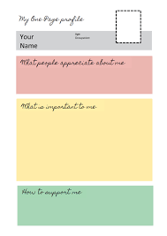
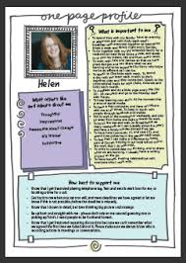
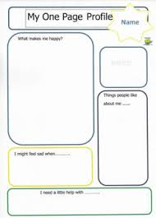
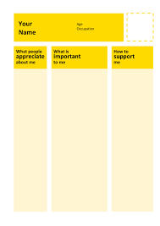
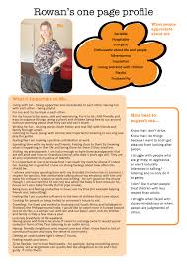
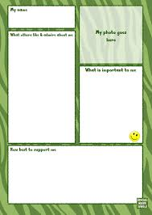
How do we capture the personalised information in a record?
One page profiles can help to ascertain what is ‘important to me’
Notes:
There are many ways in which the person centred information may be record as part of a PCSP. Organisations may use a specific record keeping format that will need to be used but there is usually way to ensure that the personalised information can be captured in this record e.g. an about me section. One way of capturing the information is through a 1 page profile. This provides a easily read summary of the information. One page profiles have been used in lots of settings, including planning with people at the end of their lives. There are some examples over the next few slides.

Slide 14
My family and friendships are what define my life. Spending time with them and staying in contact is very important to me.
For people to respect my decisions - if I am ok to work I will, if not I won’t but keeping things normal at home and work are important to my recovery.
Be sensitive if I come in wearing a scarf! I am not sure how I will deal with this yet - I may be fine or I may be self conscious. Take your lead from me I will let you know.

Slide 15
Notes:
We have been using person centred thinking tools across both health & social care to explore how we can move away from traditional mechanisms of care, where services & professionals retain control to a situation where people are more involved in how their care & support looks. .Person centred thinking is an empowering philosophy which gives us a set of tools to help in creating change.
Some of the things that Madge says are really important to her on her one page summary are - That you share with me the great things that are happening in your life – I want to hear it, it cheers me. I love grapes with the skin peeled off. I must always take my yellow bed socks Sam bought me if I have to go in hospital for a stay – they are my comfort blanket (you would also learn who some of the important people in Madges life are earlier on the one page – Sam is her son who lives in Australia).
The slide shows examples of what others need to know & do to successfully support Madge

Slide 16
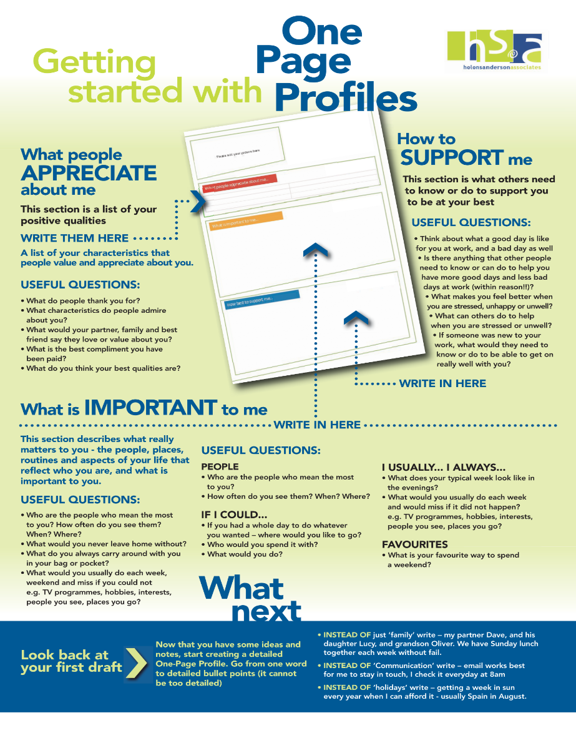
Notes:
Explain that there are 3 headings for the one page profile.
The appreciation section is a section that focuses on the things people like and admire about the person. The important to section describes all the things that are important to the person and the How to support me section describes what good support looks like to meet the persons’s needs and keep them safe and living well.

Slide 17
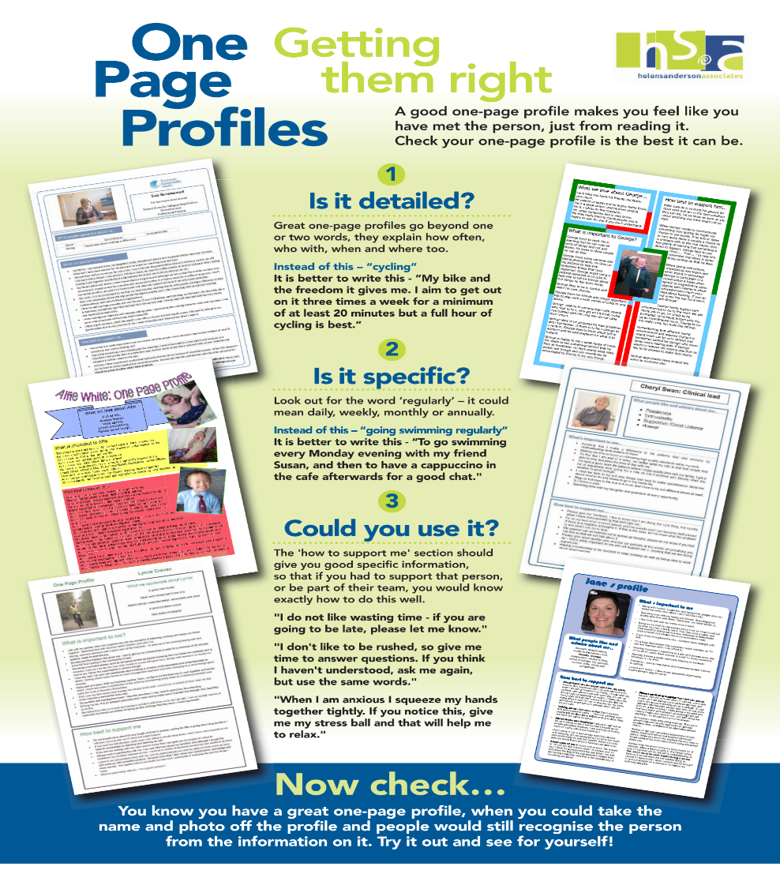
Notes:
This slide explores the key things we need to get right about one page profiles. We are looking for them to be detailed and specific enough that people will know exactly what they need to do you support somebody with the things that are important to them. Share a couple of examples to demonstrate this.
i.e. reading should be “To always have a book to read before I go to sleep but it must be a fictional book otherwise I won’t be able to sleep. I currently use the Kindle on my i pad. I love to read crime novels

Slide 18



Realities – documenting, sharing and reviewing
Notes:
Discussion – facilitator led.
How it works in general practice (documenting, sharing, reviewing).
Where might care plans be stored/ shared in the context of primary care?

Slide 19
Key learning
One page profiles can help to ascertain what is ‘important to me’, ‘important for me’.
There are challenges associated with documenting, sharing and reviewing care plans.

Slide 20
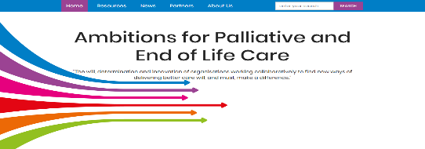
Further learning
NHS England and NHS Improvement have a webinar series which aims to provide support to professionals by raising awareness of subjects, they also share good practice. You may be interested in the following:
Person and Community Centred approaches - In 2018 NHS England funded a project to support and embed the greater introduction of person-centred approaches into Palliative, Supportive and End of Life Care for the people of Greater Manchester. This webinar articulates what great person-centred care is for people from identification as being in the last year of life through to their final days. The closing film can also be accessed HERE.
Results through Relationships – Dorset ICS were identified by NHS England as an End of Life Care test site, the aim being to incentivise progress to improve personalised care for people approaching the end of their life. In this webinar Saskie Dorman and Andy Brogan share their journey of discovery, exploration, co-design and evaluation.
The Ambitions website contains published best practice, case studies, implementation guidance and lessons learnt.
Notes:
Suggest playing the ‘Person and Community Centred approaches’ closing film as it provides a good summary.

